Slide 1
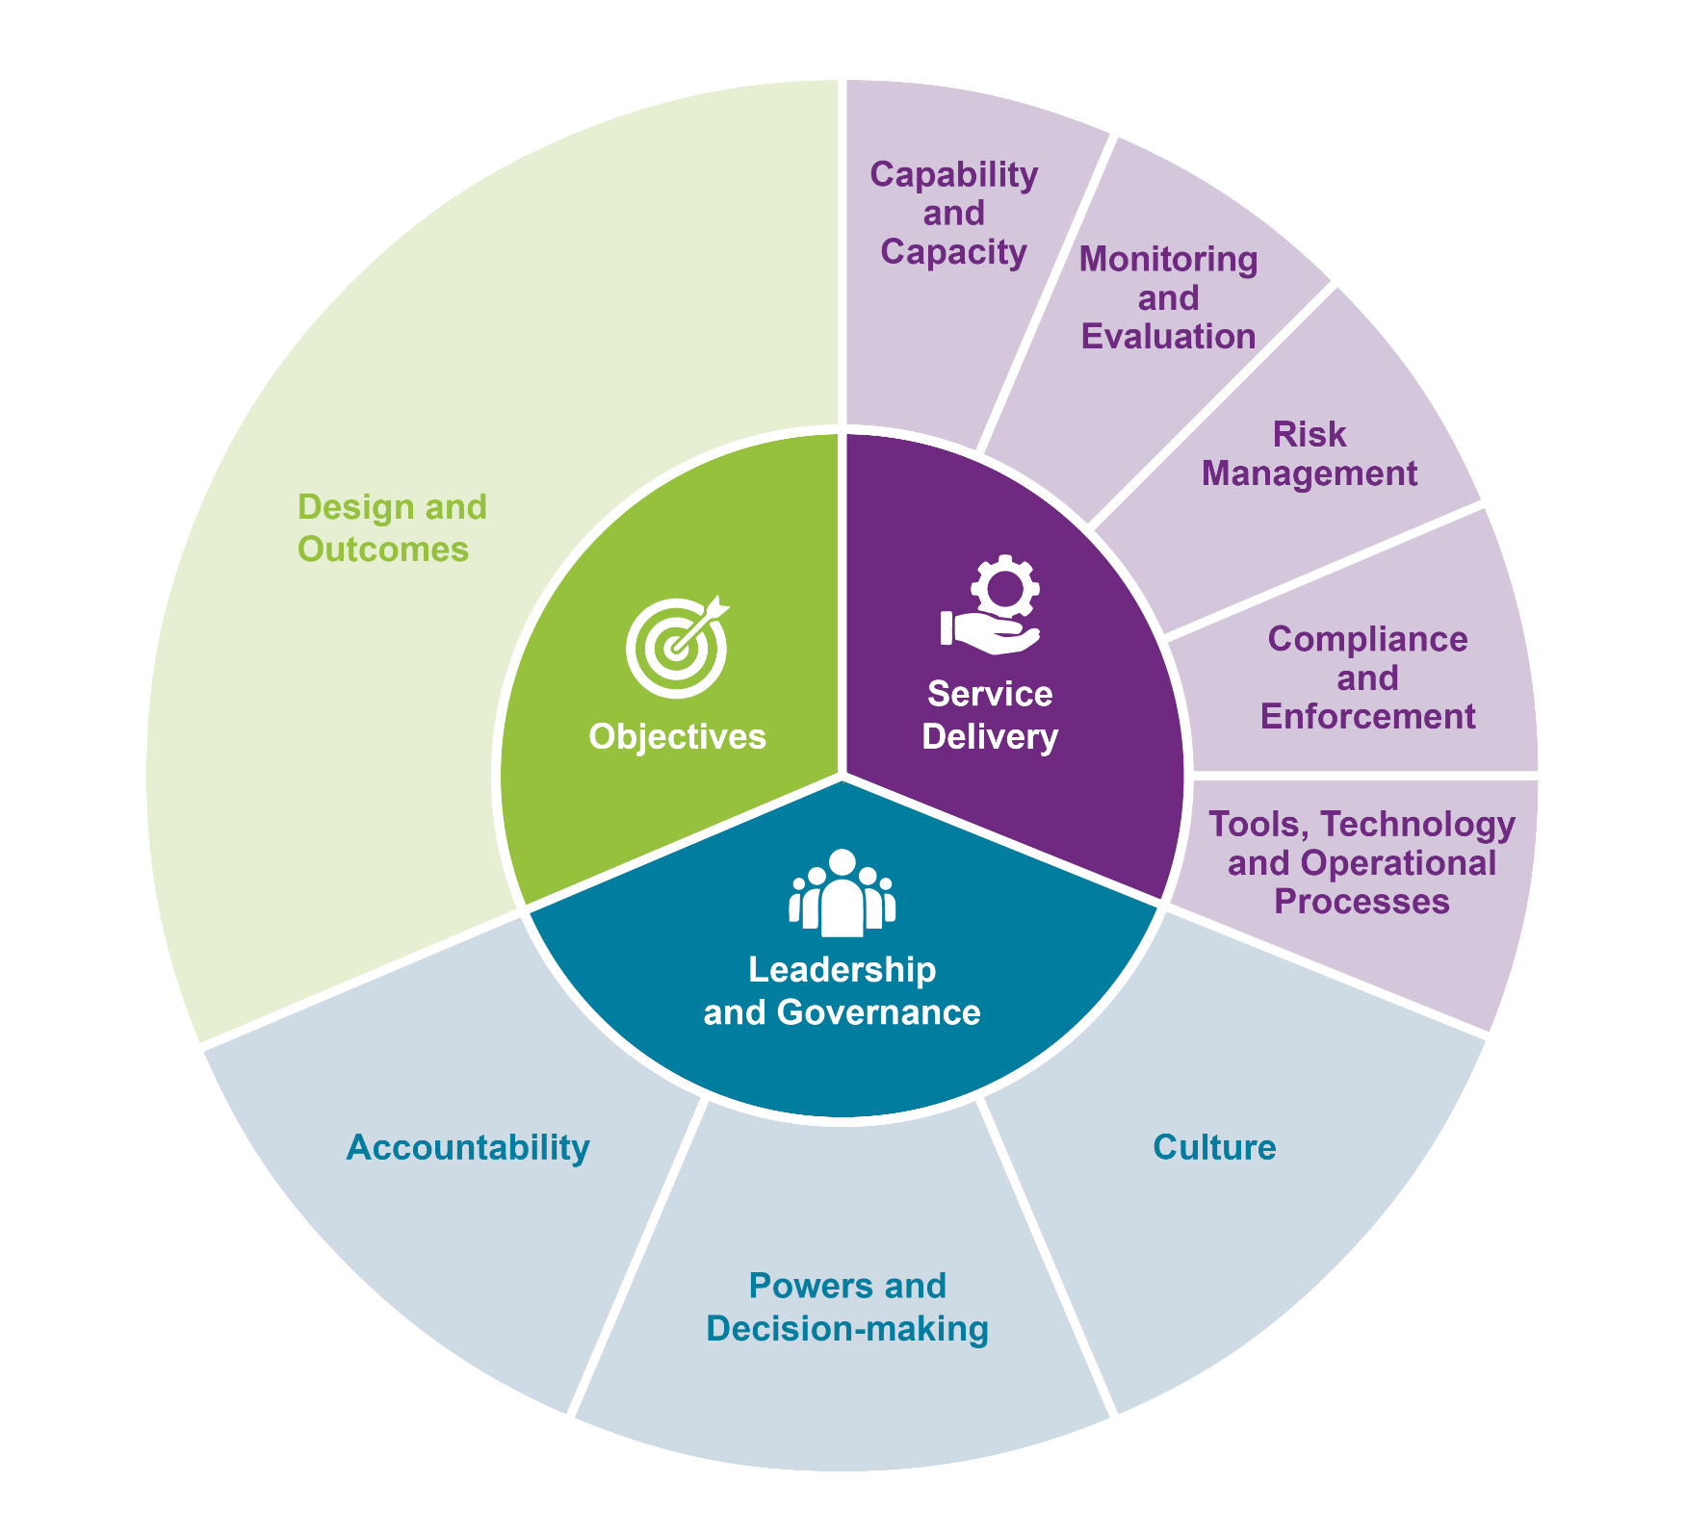
IGRS Regulatory Review Framework

Slide 2
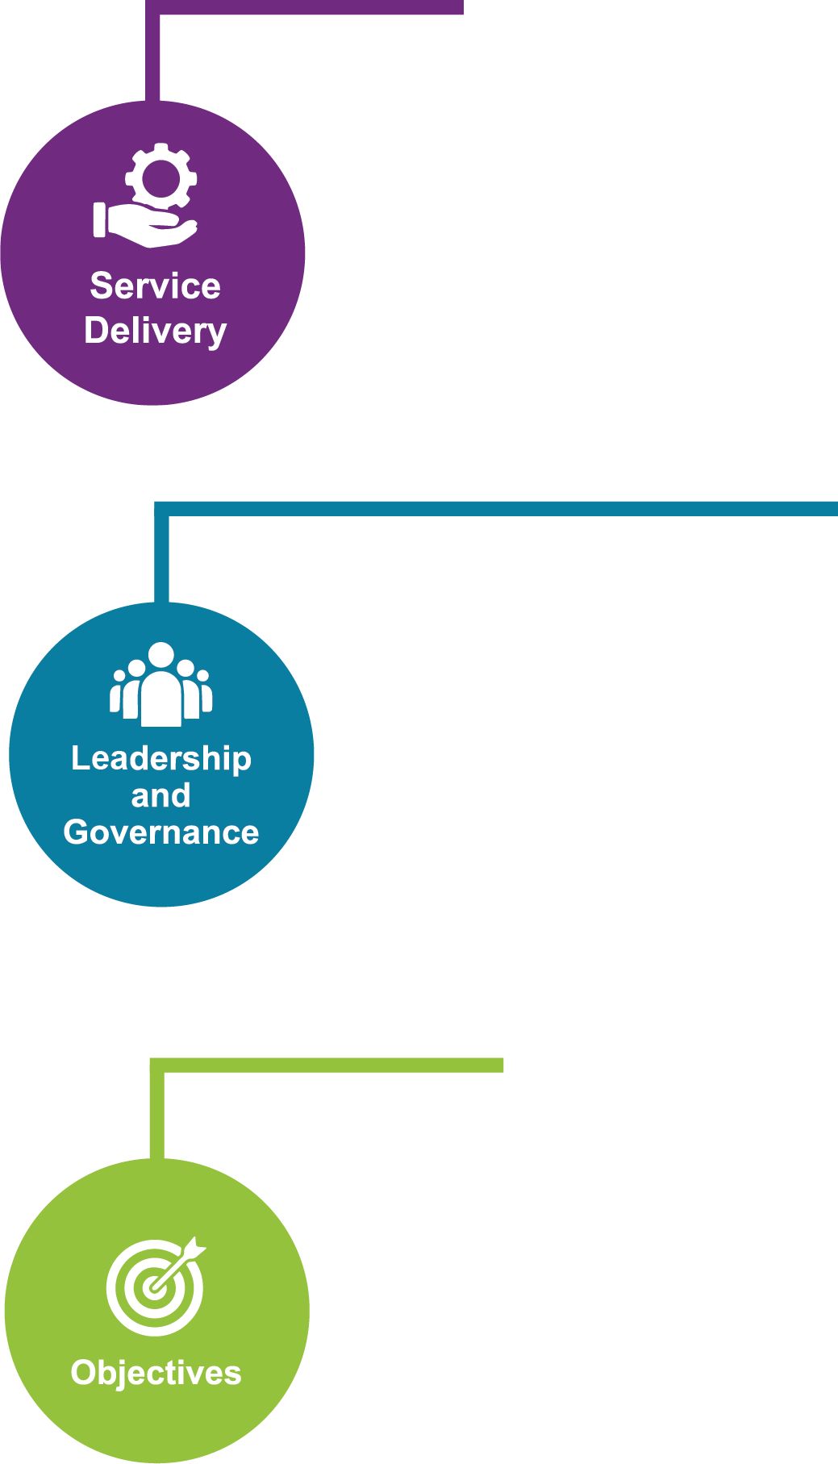
Compliance and Enforcement | Tools, Technology and Operational Processes | Risk Management
Intervention options and available tools are used appropriately, including the option not to intervene. Evidence informed, risk-based, responsive and proportionate decisions. Effective engagement with Maori and other stakeholders in the deployment of intervention options. Public awareness activities encourage regulated parties to comply e.g. information and education activities. Transparent risk-based compliance and enforcement strategy is in place, responsive and proportionate to the risks or harm being managed and is adaptable in the light of changes to markets, technologies, stakeholder’s attitudes. There is a range of effective sanctions to support desired outcomes. Regular and systematic monitoring of the impact of specific sanctions on regulated party behaviour is undertaken. | Processes are in place that produce predictable and consistent outcomes for regulated parties across time and place. There are adequate financial resources to deliver regulatory functions. There is clear articulation of funding needs, choices and impacts, and these are tested from time to time. Effective data and information management systems support and drive system improvement. Collection, management and sharing of system data and information is effective and efficient. There are effective ways of sharing and using data from other regulatory agencies, all the while ensuring privacy and data protection. Clearly articulated policies and procedures set out the approach to achieving system objectives. Identification and reduction of key data and information gaps. Insights generated from data and information collected supports continuous improvement. | There is effective identification of risk, including identification of: underlying causes of risk; the positive and negative consequences of risk mitigation options; and opportunities forgone. Ability to effectively assess, manage and respond to risk. The wider operating environment, circumstances of industry/regulated parties, and emerging issues that affect the sector are well understood. There are effective protocols in place for alerting Ministers to issues that may compromise MPI’s ability to discharge its regulatory responsibilities. Thorough impact and risk analysis of policy change options, including impact on industry, trade, international relations, and other regulatory systems is conducted. Operational data and information are available and used to inform the assessment of risk.
Monitoring and Evaluation |  | Capability and Capacity
Systematic monitoring and evaluation of the legislative framework and associated activity occurs. There is periodic review of similar regulatory systems for trends, threats, linkages, opportunities, innovation and good practice. There is sufficient assurance activity to give comfort over the operations of all components of the regulatory system. There is regular testing of operating assumptions, and experiences of parties affected by system rules and practices. Analysis and application of monitoring data and information to drive performance and build confidence intended outcomes are being delivered. Protocols for prioritising resources according to the value/importance of work. | Proactive use of monitoring data and information to identify and assess and report on problems, vulnerabilities and opportunities for improvement in the design and operation of the system. Employment of service design, continuous improvement and innovation techniques to provide good regulatory experiences for customers and stakeholders. Sharing of frontline service delivery performance information with policy to support regulatory design. Operation of powers monitored through appropriate oversight arrangements. Legislation remains fit for purpose in the context of current social licence. | Staff have the knowledge, qualifications, skills, tools and support to effectively discharge their responsibilities. Continuing training and development of staff is prioritised. Career pathways clear and available. Actions/activities contribute to building the regulatory capability of regulated parties. Actions/activities contribute to wider regulatory capability-building initiatives within the public sector. There is a regular review of services provided to regulated parties to ensure capability and capacity are appropriate and efficient. Performance monitoring data and information is regularly and openly shared across system components.

Slide 3
Design and Outcomes
Clearly articulated regulatory system objectives, functions and authorisations. Clear strategy and objectives for regulatory system that consider short and long-term impacts and outcomes. Achievement of objectives in the most cost-effective way, with the least adverse impact. Conforms with New Zealand’s constitutional principles and legal obligations. Policy, regulation and services are consistent with New Zealand’s international obligations, international standards and best practices. | Actively builds in Treaty of Waitangi considerations. Seeks to maximise the benefits from trade e.g. cross border flows of goods, people, capital and services. Treats regulated parties proportionately and equitably. Cost/benefit of change options, including implementation issues, e.g. economic environmental, social, resourcing, etc., are identified and understood. Flexibility to allow regulators to adapt approach to the needs of different regulated parties. | Regulated parties are able to determine how they meet regulatory requirements. Opportunity during regulatory design process for affected and interested parties to scrutinise and comment on proposed statutory changes, and where appropriate participate directly. Established processes for dealing with conflicts (perceived or otherwise) between regulatory system outcomes. Risk is assigned to the appropriate party i.e. individual, company, government.
Accountability | Culture | Powers and Decision-making
Appropriate governance and accountability arrangements, structures, policies, procedures and decision-making processes exist. Governance is regularly (self) evaluated for effectiveness. System leadership is well defined, reviewed periodically, and supported by effective risk-management practices. Senior leaders have a common understanding of the system expectations, risks, and performance. There are simple and straightforward ways to engage with regulated parties, and to hear and respond to stakeholder views. There are appropriate mechanisms for feedback, challenge and appeal for those affected by regulatory activities. | Leaders are focused on regulatory objectives. Leaders set clear expectations and model expected standards of conduct. There is a culture of measurement and evaluation of regulatory impacts and outcomes. Culture promotes operational flexibility and adaptation to change. Culture that promotes continuous learning, continuous improvement, and health and safety. Culture that supports the role as an educator and facilitator of compliance. Staff are empowered/ incentivised to act in the long-term interests of the system. Safe to challenge status quo, consider different approaches, share lessons learnt, and raise risks. Staff can articulate how their work contributes to achieving overall system objectives. Staff coordinate effectively to align system activity and improve system operation. There is genuine partnership and collaboration with Maori in accordance with the principles of the Treaty of Waitangi. Well understood and articulated system value propositions. | Powers appropriate to role and function, are clearly communicated and understood. Clear internal rules and delegations exist, which underpin the use of powers, and appropriate oversight mechanisms. Robust procedures exist to support good regulatory decision making that is fair, impartial and consistent. Decision makers know where/when to seek guidance. Information about regulatory decision-making processes, including timelines and principles that inform decisions, is maintained and communicated to stakeholders. Clarity of role of, and relationship with, other regulatory agencies, and any gaps or overlaps. Effective working relationships are in place with relevant agencies. Understanding of how to interact with and influence other (co)/regulators. There are methods in place for empowering parties to intervene to help achieve regulatory outcomes.

